Slide 1

SAR ADC
Cédric Hirschi

Slide 2
Table of contents/Agenda
Task Description
State Diagram / Function
Module Overview
SAR ADC Principle
Further ideas
Demo

Slide 3
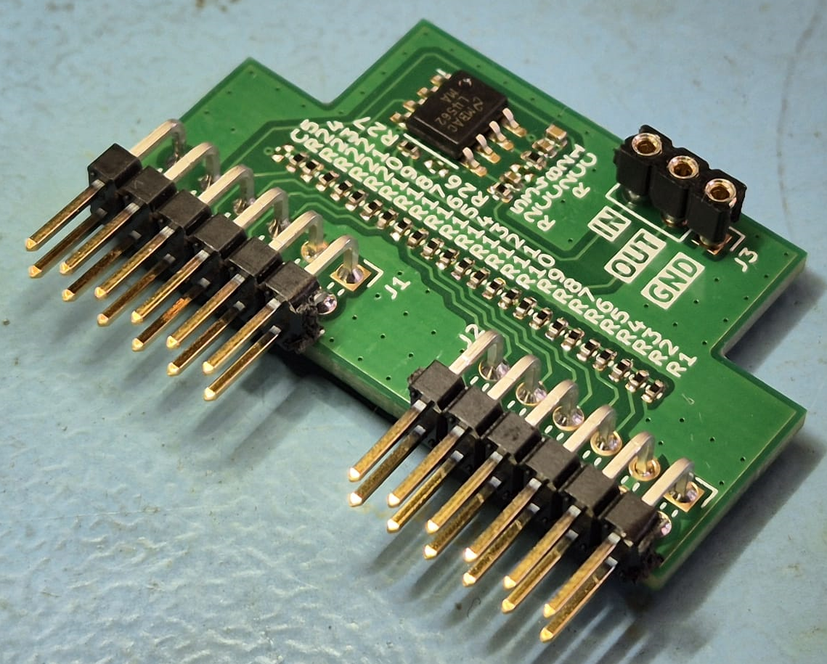
Task Description
Build a SAR ADC and a way to read its values.
Build analog part
Develop SAR core
Develop UART readout core
Optional: Evaluate speed and accuracy

Slide 4
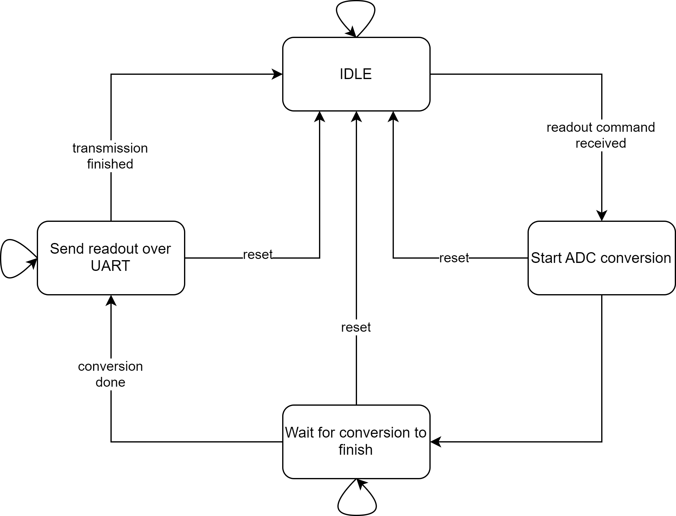
State Diagram and Function of the SAR ADC

Slide 5
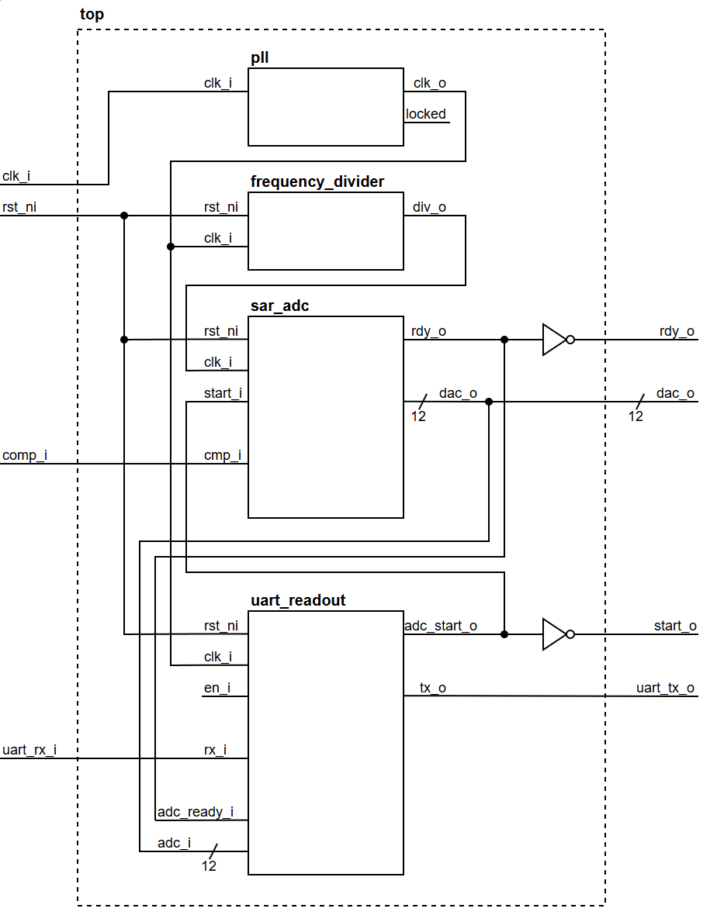
Module Overview

Slide 6
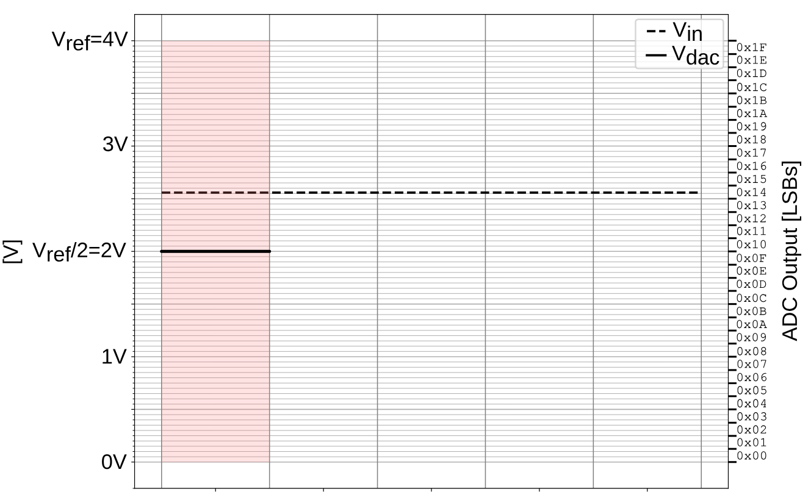

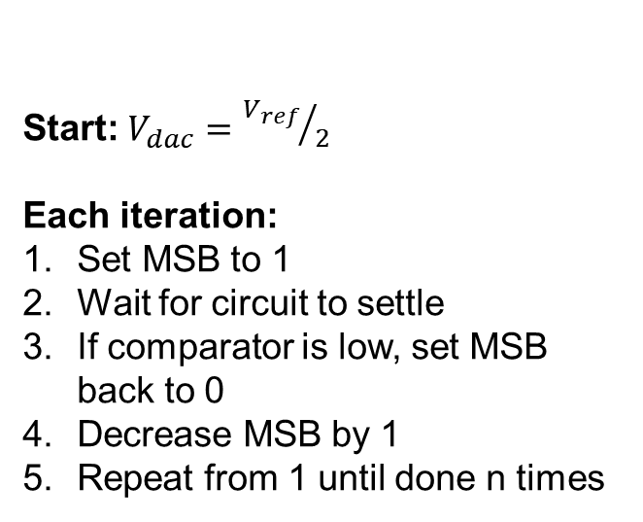
SAR ADC Principle
Principle of Binary Search
→ Ο(log n) worst case technically, here we always make n (resolution) iterations
Start: $V_{dac}={V_{ref}}/2$
Each iteration:
Set MSB to 1
Wait for circuit to settle
If comparator is low, set MSB back to 0
Decrease MSB by 1
Repeat from 1 until done n times
2.55V
Result:
$$V_{adc}=\frac{20 (10100)}{32}∙V_{ref}=2.5V$$
1
0
1
0
0
ADC shift register
Source: Embedded Systems Lecture HS2023, Exercise 5 slide 5

Slide 7
Further Ideas
The analog part implementation is more of a proof of concept, not made for accuracy or speed. This could be engineered more carefully.
The ADC could be integrated into a larger project
Instead of using parallel outputs for the R-2R DAC, use different implementation to save pins

Slide 8
Demo

